Slide 1
INTRODUCTION
By: Yi Heng and Didum

Slide 2
Project Aims
Project Name: Susmongus
We aim to utilise machine learning to differentiate face shapes from using the values of facial features from many different people, through the use of validation, testing and prediction.

Slide 3
CHAPTER 1: GATHERING DATA FOR SUSMONGUS

Slide 4
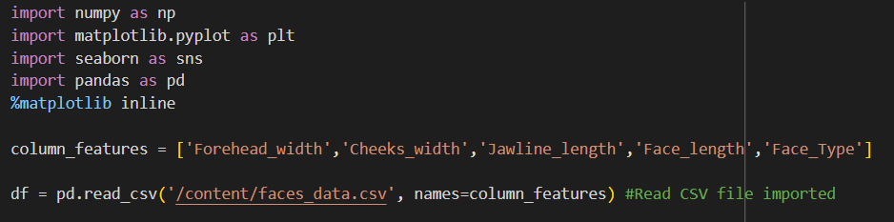
How did we find our data ?
For Susmongus
We utilised a given csv file for us
Using panda to read the csv file

Slide 5
CHAPTER 2: PREPARING DATA FOR SUSMONGUS

Slide 6
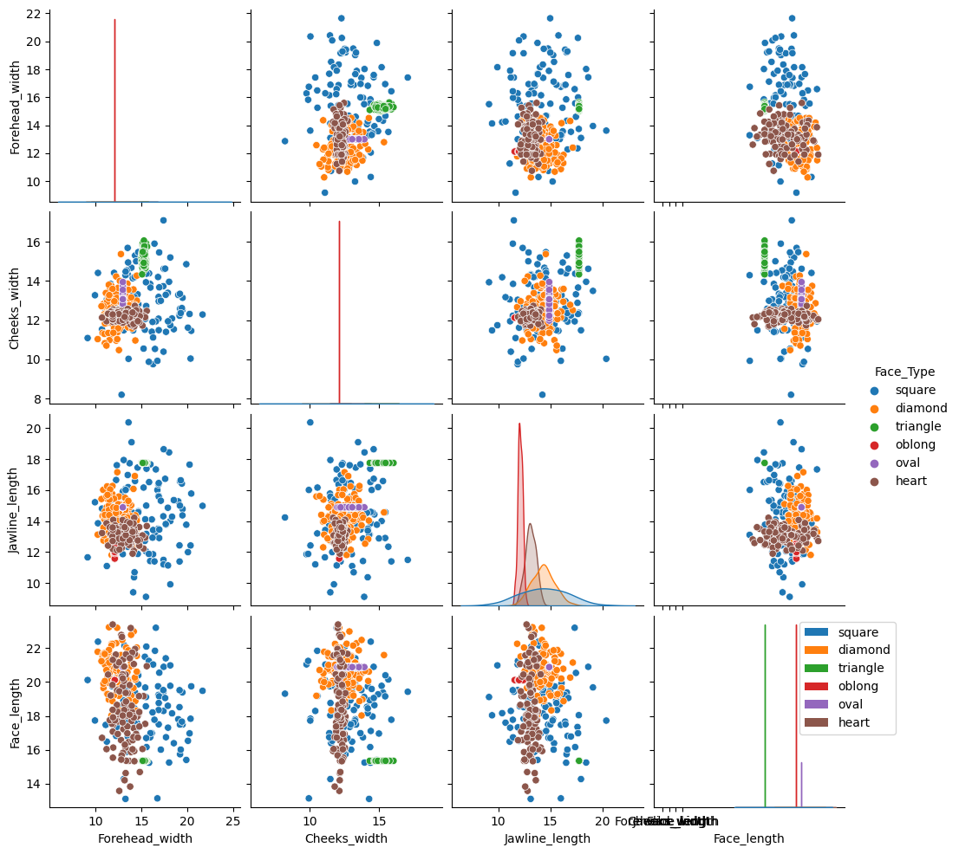
Using Seaborn

Slide 7
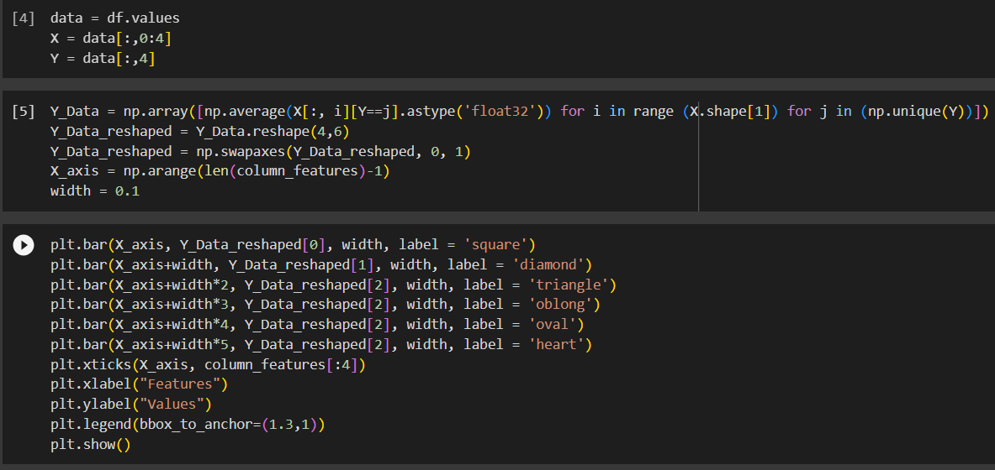
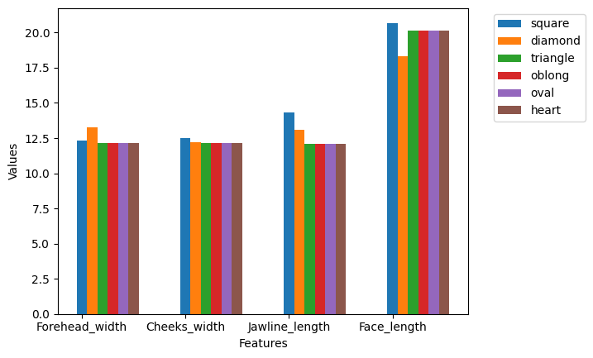

Slide 8
CHAPTER 3: CHOOSING A MODEL

Slide 9
Why did we choose DecisionTreeClassifier
Decision trees do not make strong assumptions about the distribution of the data, while both KNN and SVM assume that the data follows certain patterns (e.g., local similarity in the case of KNN, or linear separability in the case of SVM).
Decision trees can handle non-linear relationships in the data without the need for complex transformations. In contrast, SVMs can handle non-linearity through kernel tricks, but they require careful selection of the kernel and hyperparameters.

Slide 10
CHAPTER 4: EVALUATION

Slide 11
Description of Evaluation results
During our testing, we used a test split of 0.3 which indicates that 70% of data was used for validation while 30% of data was used for testing.
We managed to obtain an accuracy score of above 80% on numerous occasions.
Furthermore, after testing, we used new values and tested the accuracies of our model.

Slide 12

Average Results
Diamond | 0.79
Heart | 0.72
Oblong | 1.00
Oval | 0.67
Square | 1.00
Triangle | 1.00
Precision
Diamond | 0.70
Heart | 0.75
Oblong | 0.96
Oval | 1.00
Square | 0.77
Triangle | 1.00
Recall

Slide 13
CONCLUSION: HOW WOULD YOU DEPLOY THE MODEL

Slide 14
How can we use this in the future
We can utilise these models with more dimensions, to identify people with similar features
With the addition of more facial features, we are able to identify those of other races, cultures and ethnicity.
However, the addition of more dimensions may be difficult to integrate into our collab notebook, and not worth the time spent.

Slide 15
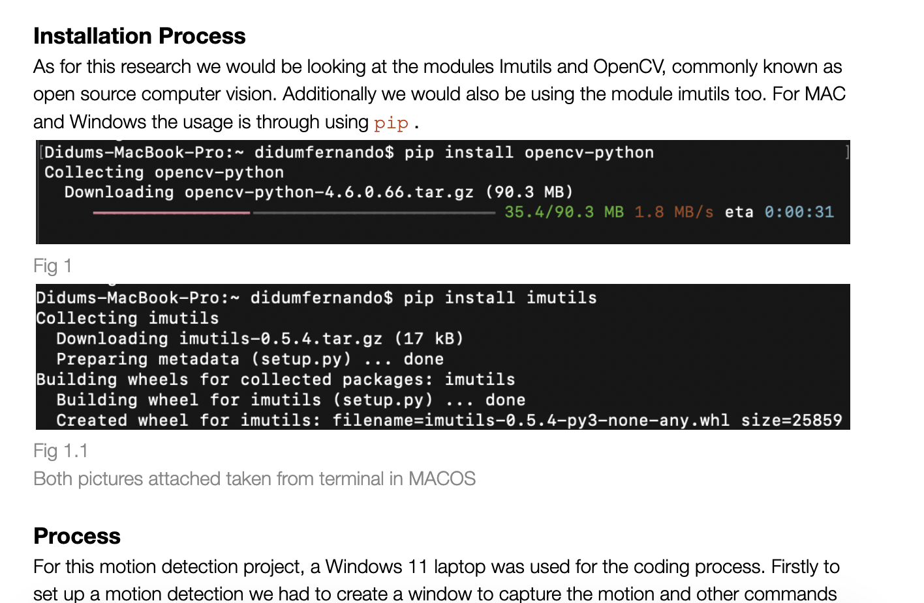
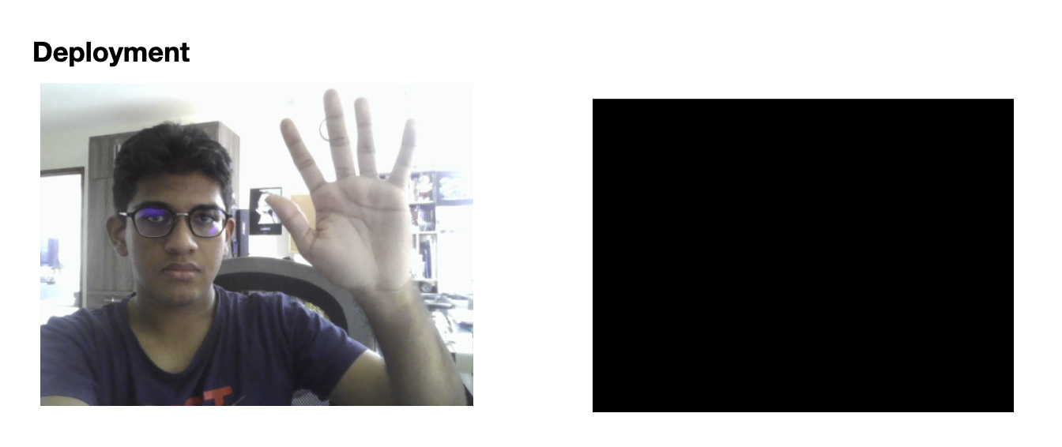

Slide 16
Conclusion
Our models were able to be accurate an overwhelmingly large majority of times with accuracy scores above 0.85.
We managed to achieve our main objectives of being able to accurately detect people’s face shape

Slide 17
Thank You!
Credits: Ms Carmen for code/comments/slide template/datasets/videos
“If you ever need chatgpt in asr, call aakarsh, asrgpt.”
Mr Gi, Top Gi, circa 26/10/23 @ 10.45am at 1112

